Slide 1
Health Awareness and Nutrition
Dietary Guidelines for Healthy Living
Department of Clinical Nutrition and Dietetics College of Health Sciences

Slide 2

Dietary Guidelines
Science-based advice:
Promote health
Reduce risk of major chronic disease
Target people:
Apply to most people age 2 and older
The Dietary Guidelines are revised and reissued every 5 years.

Slide 3
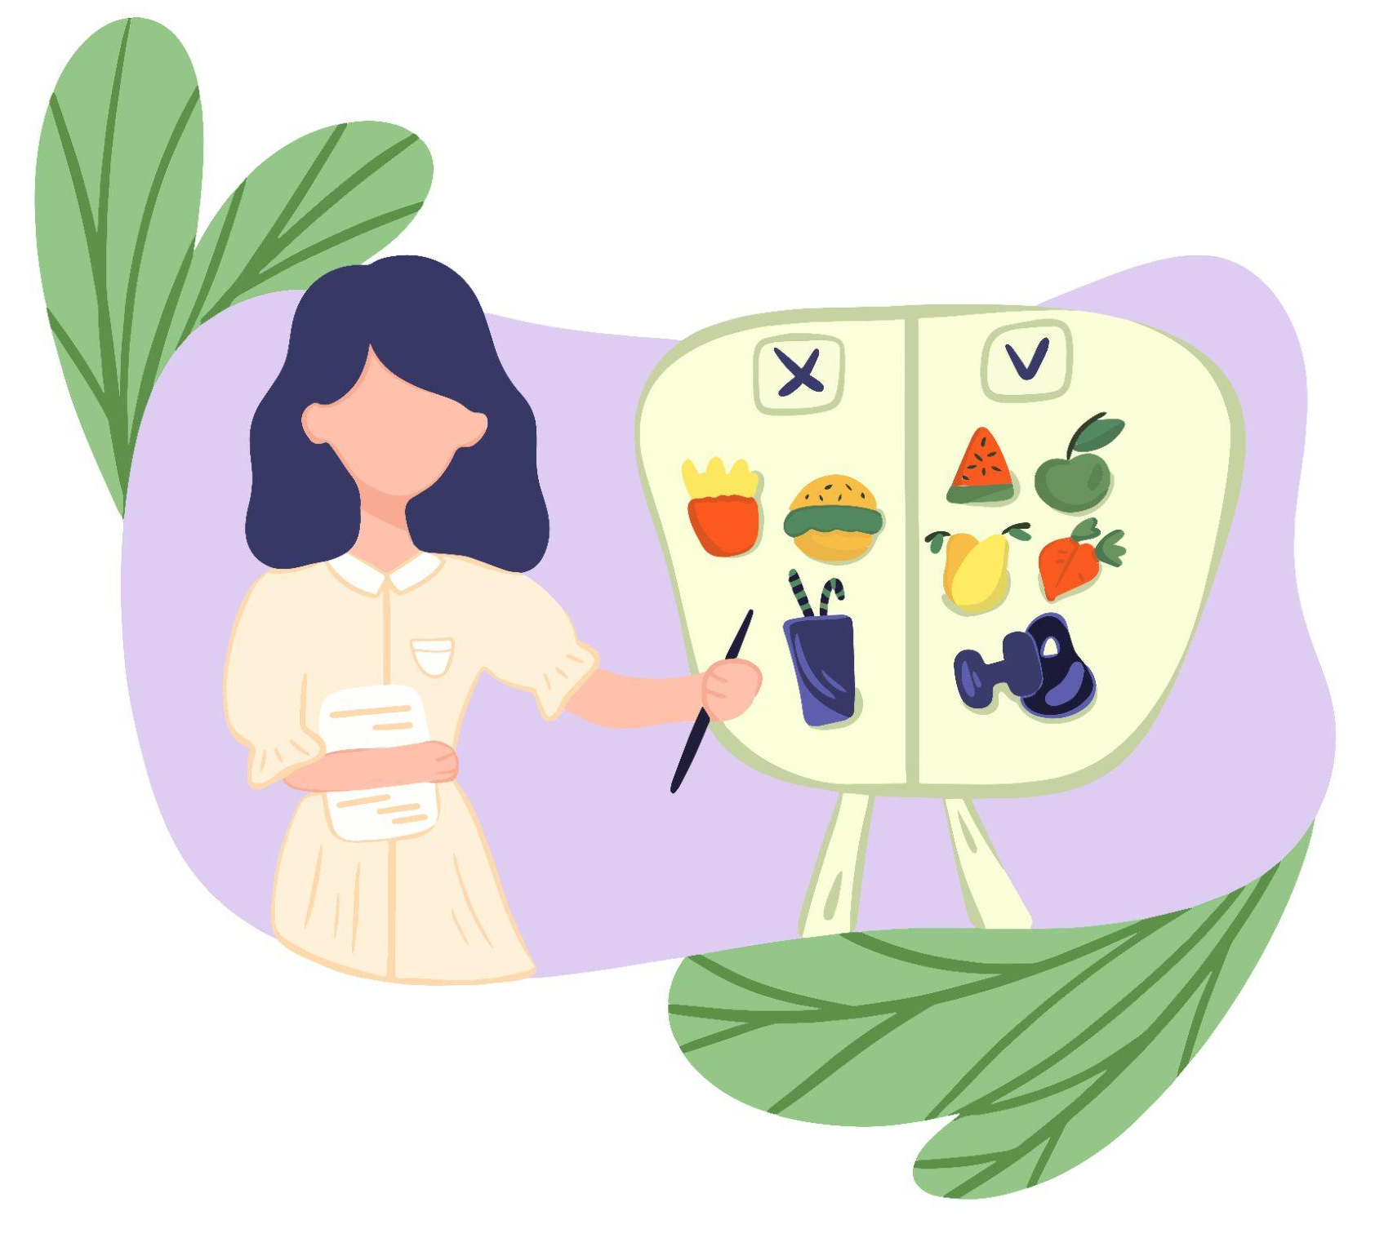
Dietary Guidelines
Help people choose nutritious foods and limit potentially harmful dietary components like:
Fat, sugar, cholesterol, salt, and alcohol
Incorporate food preferences of different racial/ethnic groups, vegetarians, and other groups when planning diets.
Help in developing educational programs and material.

Slide 4
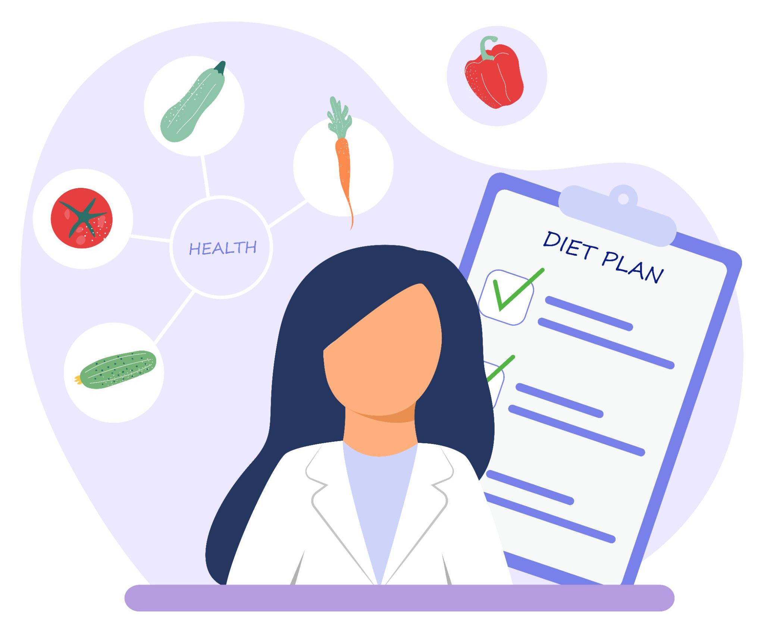
Why Are Guidelines Important?
Dietary Guidelines address significant nutrition-related health issues facing the population such as:
Obesity and other diet-related chronic disease
Cardiovascular Disease (CVD)
Type 2 Diabetes Mellitus (DM)
Cancer

Slide 5
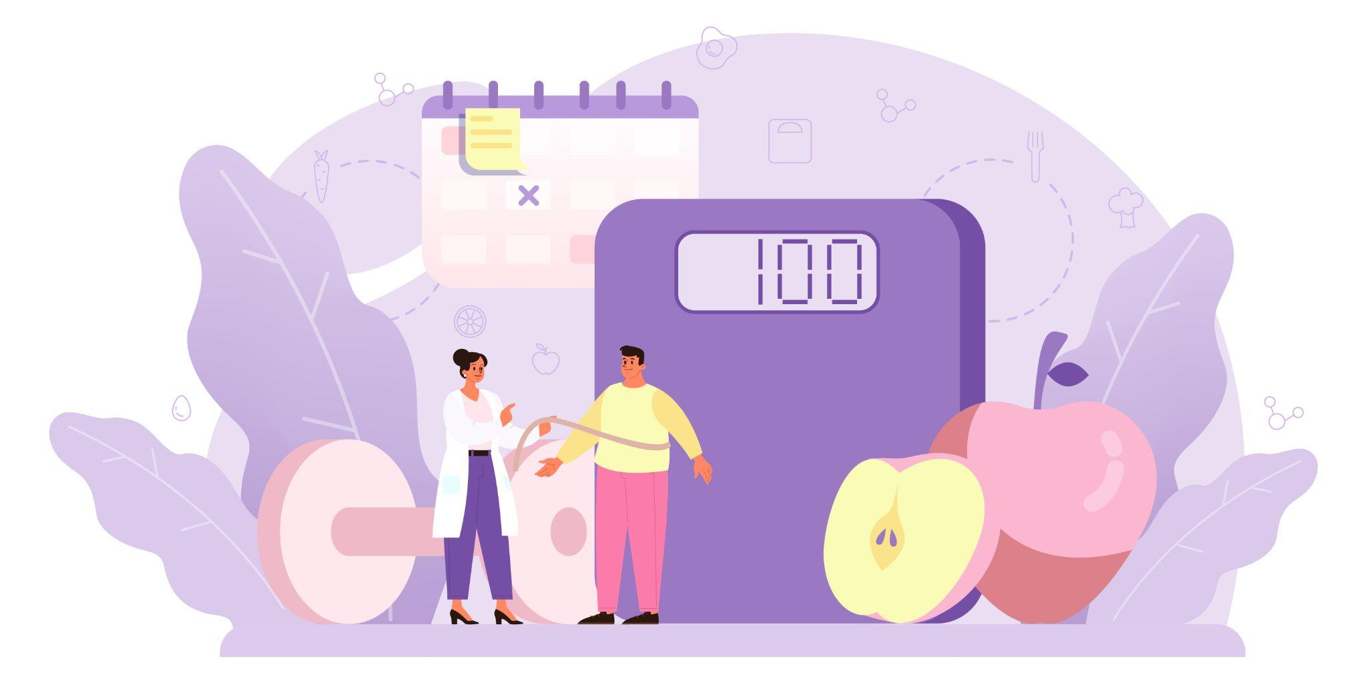
Why Are Guidelines Important?
The Dietary Guidelines report provides evidence-based food and beverage recommendations for ages 2 and older.
These recommendations aim to:
Promote health
Prevent chronic disease
Help people reach and maintain a healthy weight

Slide 6
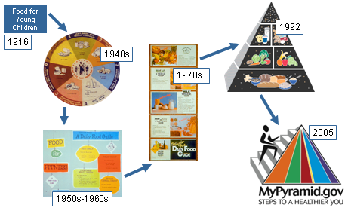
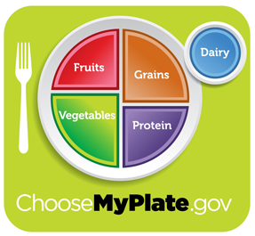
History of USDA’s Food Guidance
2010

Slide 7
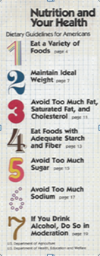
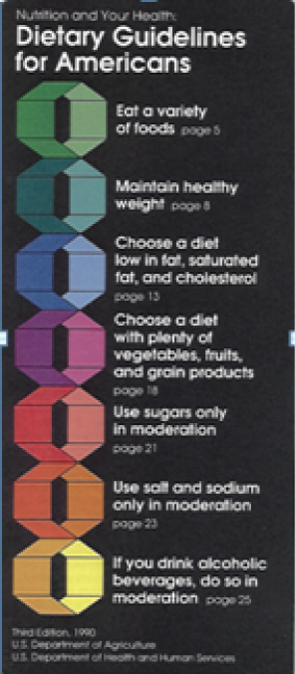



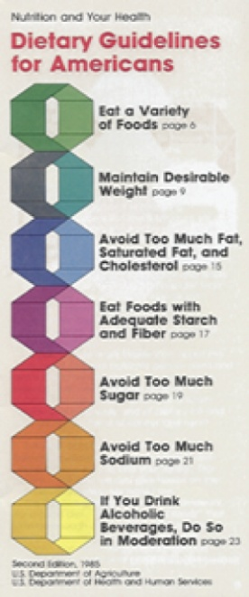
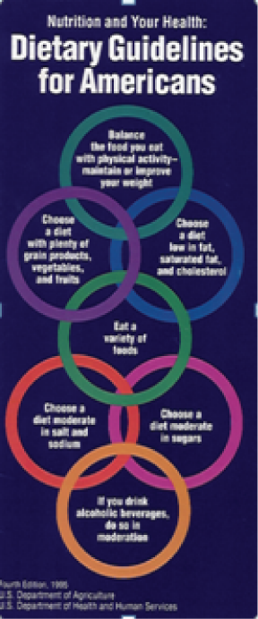

Purpose and History:
Dietary Guidelines for Americans
2005
2000
1980
1990
2010
1985
1995
2015

Slide 8
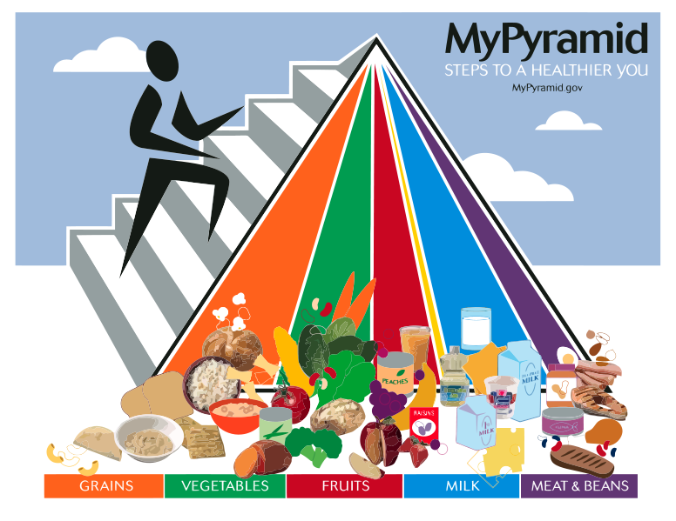
Food Guide 2005
This symbol has been chosen to be simple
Designed to remind consumers to make healthy food choices and to be active every day
Small steps make substantial impact on health
Sport Activities
Food Groups

Slide 9
Dietary Guidelines
The My Plate Icon is designed to:
Help consumers make better food choices
Remind Americans to eat healthfully
Illustrate the five food groups using a familiar mealtime visual: a place setting

Slide 10

2015-2020
Dietary Guidelines for Americans
Three key messages focus on helping consumers work toward a life-long pattern of consuming nutrient-dense foods and beverages while staying within calorie needs.

Slide 11
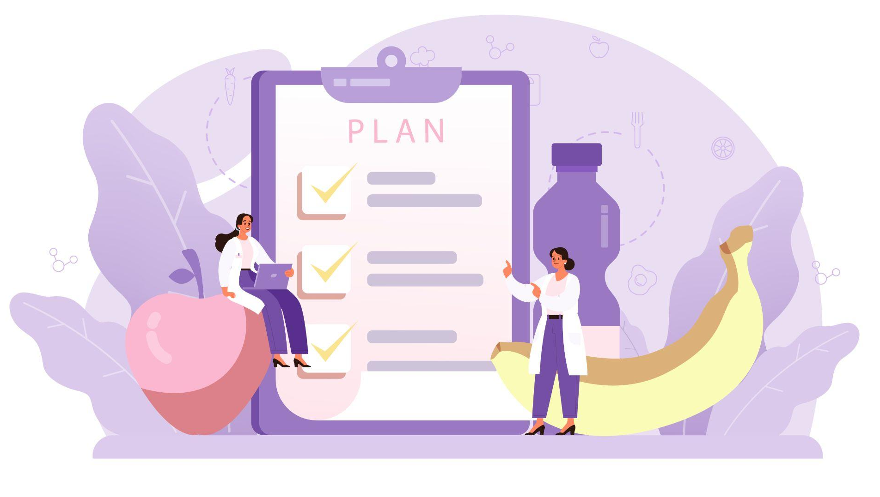
Three Key Messages
1. Eat for health and the long run:
Healthy eating patterns include all foods and beverages consumed over a long span of time, and they can be flexible and adaptable to your tastes and preferences.
Include a large variety of fruits, vegetables, whole-grain products, and lean proteins and legumes. Add healthy fats from nuts, seeds, and vegetable oils.
Healthy eating patterns are low in added sugars and saturated/trans fats. Aim for <10% of calories from these groups.
Healthy eating patterns are low in sodium from processed foods. Aim for <2300 mg/day.

Slide 12
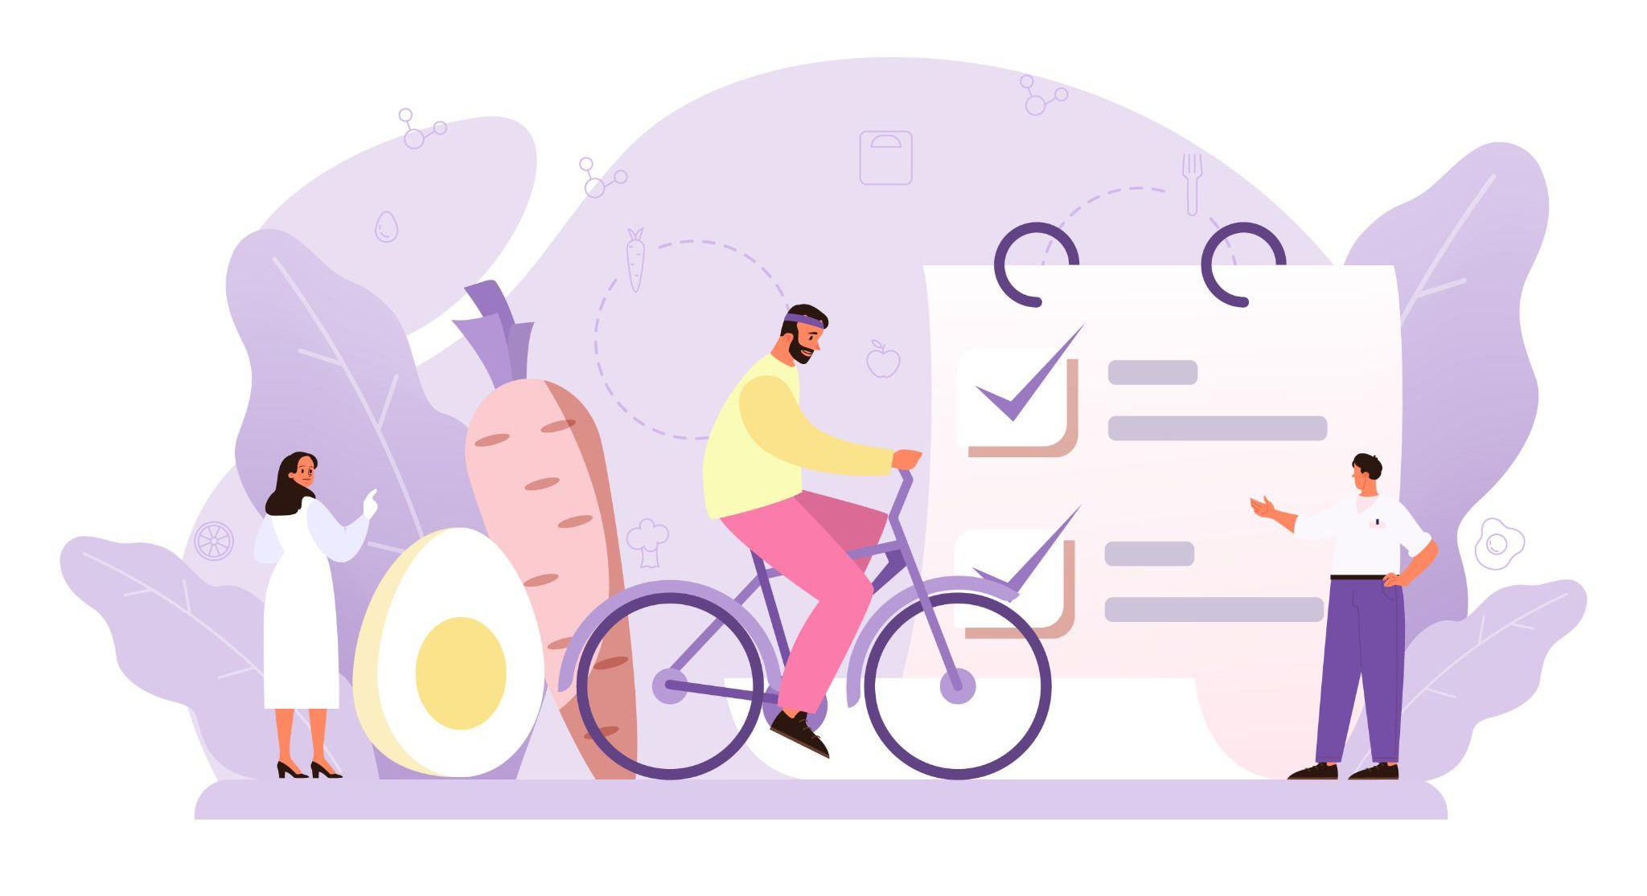
Three Key Messages
2. Start with shifts, or small changes:
All foods and beverages count toward a healthier meal pattern
Shift toward more nutrient-dense choices within and across food groups
Small changes add up
Accommodate personal tastes and cultural preferences to make the shift easier to maintain

Slide 13

Three Key Messages
3. Support healthy choices for everyone:
Healthy food, beverages, and physical activity choices should be available to all ages and throughout the food system:
Schools
Workplace
Community and restaurants
Grocery stores and home
Professionals in these sectors should develop strategies that help individuals align their choices with the Dietary Guidelines.

Slide 14

Dietary Guidelines: Key Recommendations
I. Consume a healthy eating pattern that accounts for all foods and beverages within an appropriate calorie level
II. Meet the Physical Activity Guidelines for Americans

Slide 15

Food-Based Dietary Guidelines -
United Arab Emirates (2019)
Main Goals:
Improve the nutritional status of the United Arab Emirates (UAE) population.
Prevent poor nutrition, obesity, and chronic diseases.
Reduce the rate of chronic diseases such as diabetes mellitus, hypertension, heart diseases, and cancer.

Slide 16
Food-Based Dietary Guidelines -
United Arab Emirates (2019)
Messages:
Support and strengthen a healthy lifestyle through a healthy diet and physical activity for all.
Maintain healthy eating at all stages of life.
Reduce calories by reducing sugar, fat (especially saturated and trans fat), and salt intake.
Consume diversified nutrient-rich foods and beverages.
To adopt healthy eating patterns, replace unhealthy foods with healthy foods.
Ensure food safety.

Slide 17

Food-Based Dietary Guidelines -
United Arab Emirates (2019)
Food Groups:
It is divided into six food groups, each one represented with a unique colour.
What distinguishes UAE food guide is the addition of water as a group representing the base of the Burj with a blue color.

Slide 18
Food-Based Dietary Guidelines -
United Arab Emirates (2019)
Food Groups:
The food groups (in addition to water) are:
1) Cereals and starches
2) Vegetables
3) Fruits
4) Dairy products
5) Meats and proteins
6) Fats
Notes:
The Burj Khalifa Demonstration for UAE National Nutrition Guideline is still under review and maybe another demonstration will be used instead of the Burj Khalifa

Slide 19
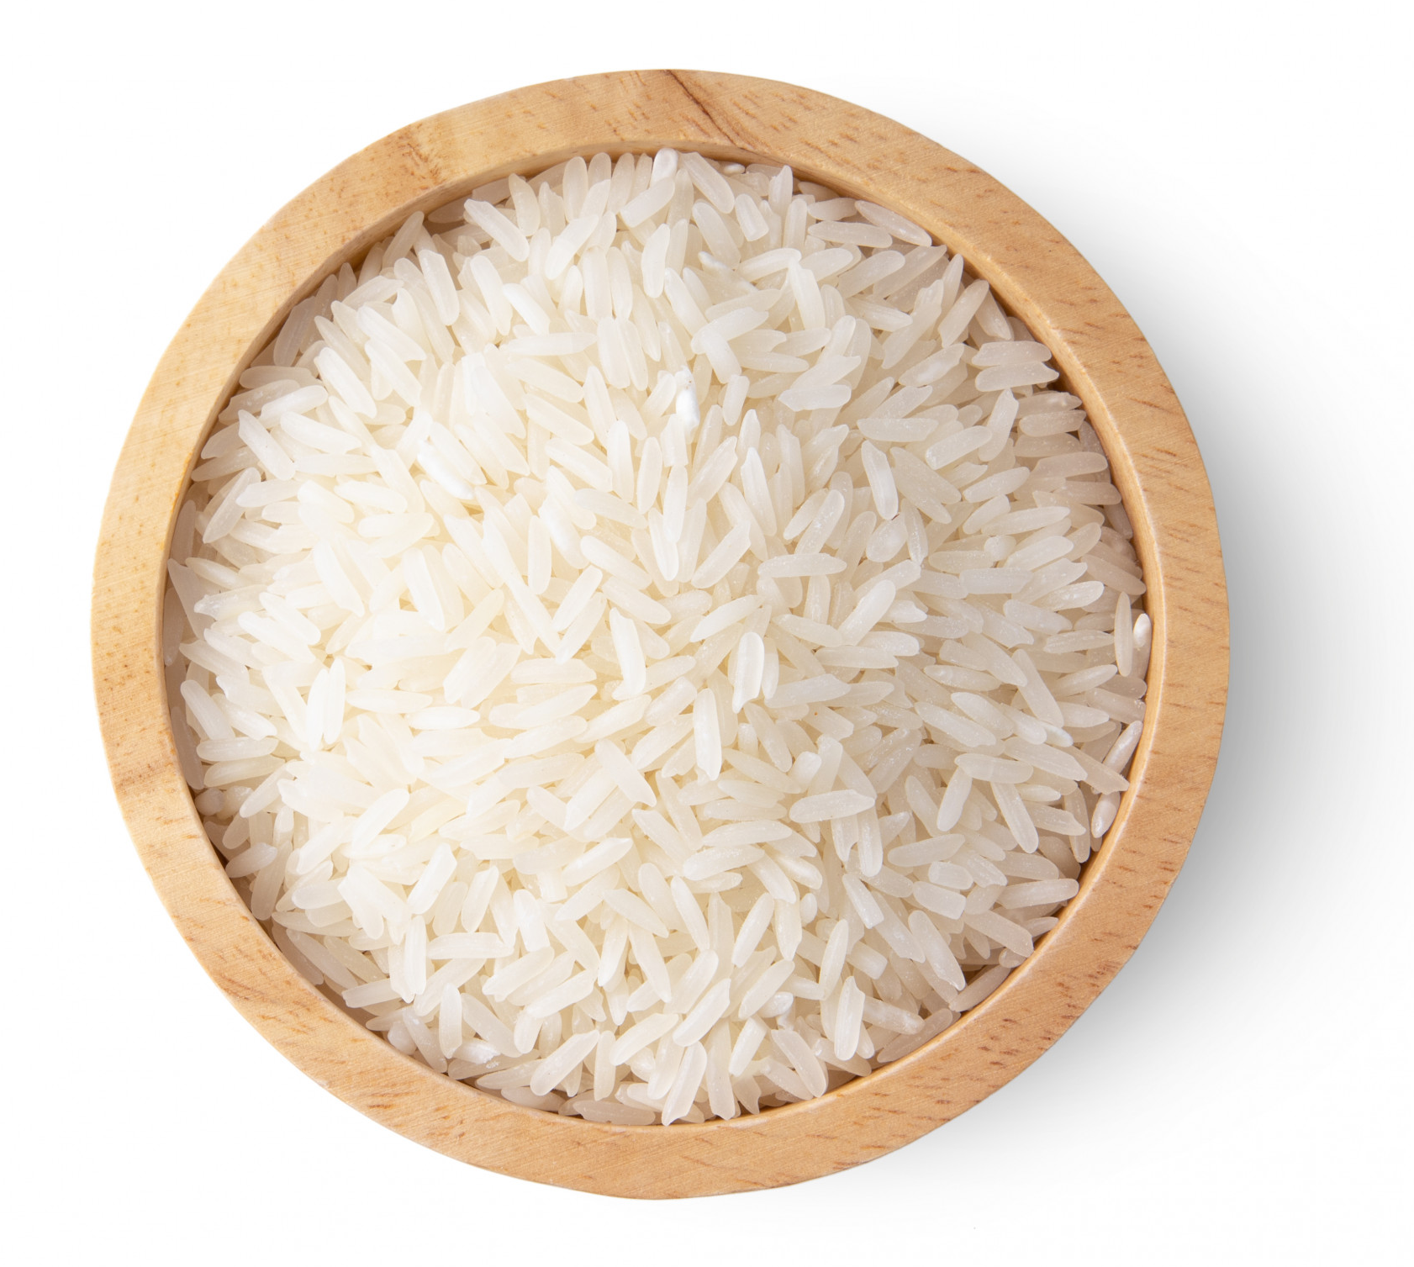
Food Groups: Grains
Any food made from wheat, rice, oats, bread, pasta, and breakfast cereals is in the grain group.
Grains are divided into two subgroups:
Whole Grains and Refined Grains
Whole grains contain the entire grain; the bran, germ, and endosperm
Refined grains have been processed and dietary fiber, iron, and many B vitamins were removed. (ex: white rice and flour)

Slide 20
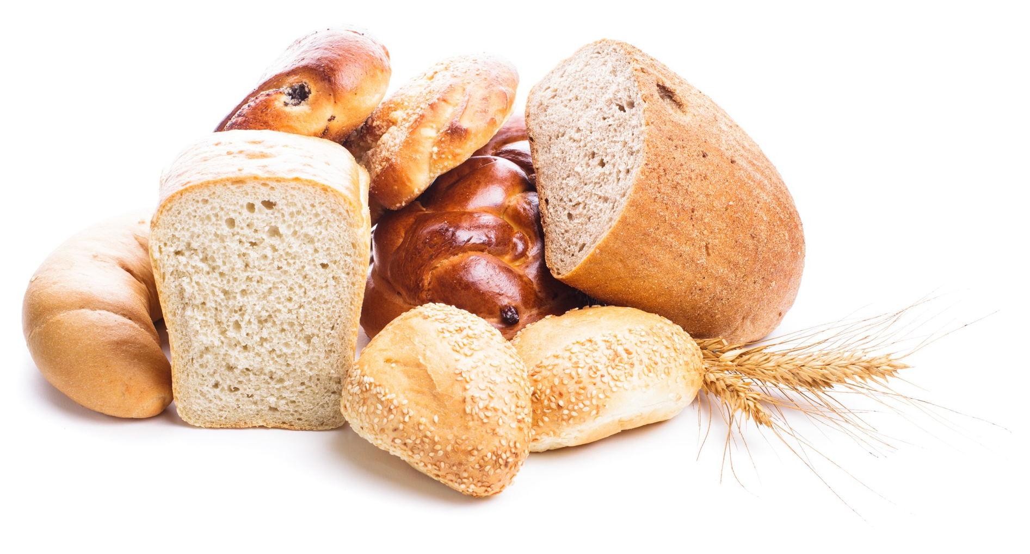
Food Groups: Grains
Key Consumer Message:
Make at least half of your grains whole grains.
How much is needed?:
Consume 3 or more ounce (85 - 100g) – equivalents of whole-grain products per day
What counts as an ounce?
1 slice of bread
1 cup of ready-to-eat cereal
½ cup of cooked rice or pasta

Slide 21
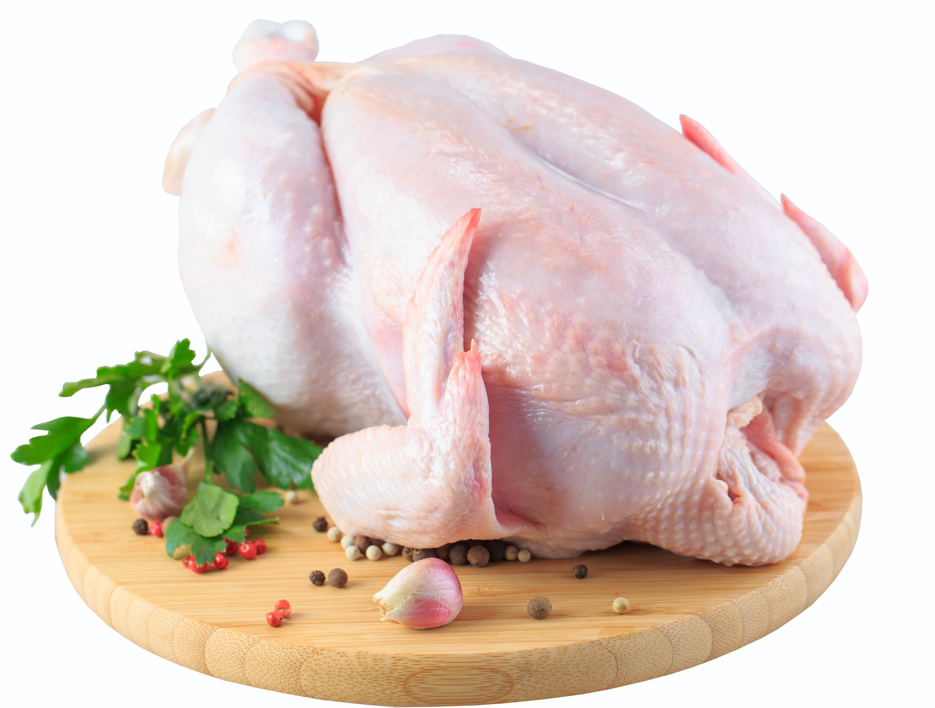
Food Groups: Proteins
Includes all foods made from meat, poultry, seafood, beans and peas, eggs, processed soy products, nuts, and seeds.
Choose low-fat or lean meats and poultry.
Include at least 2 portions of cooked seafood per week.
Vegetarian options in the Protein Foods Group include beans and peas, processed soy products, and nuts and seeds.

Slide 22
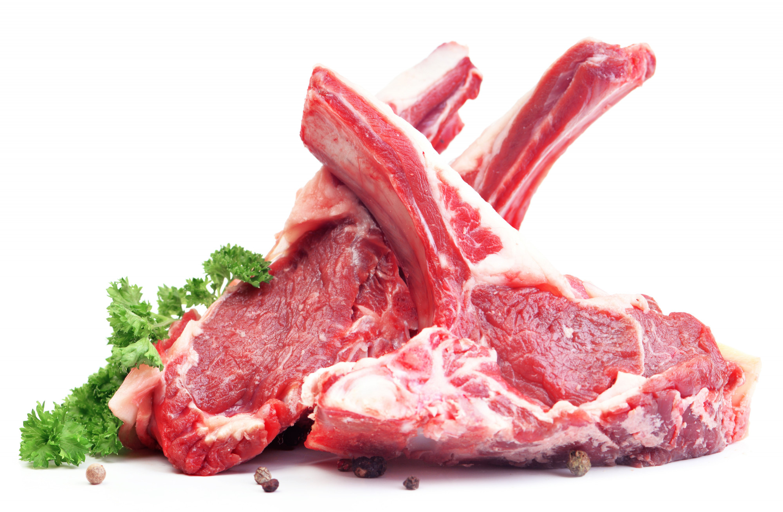
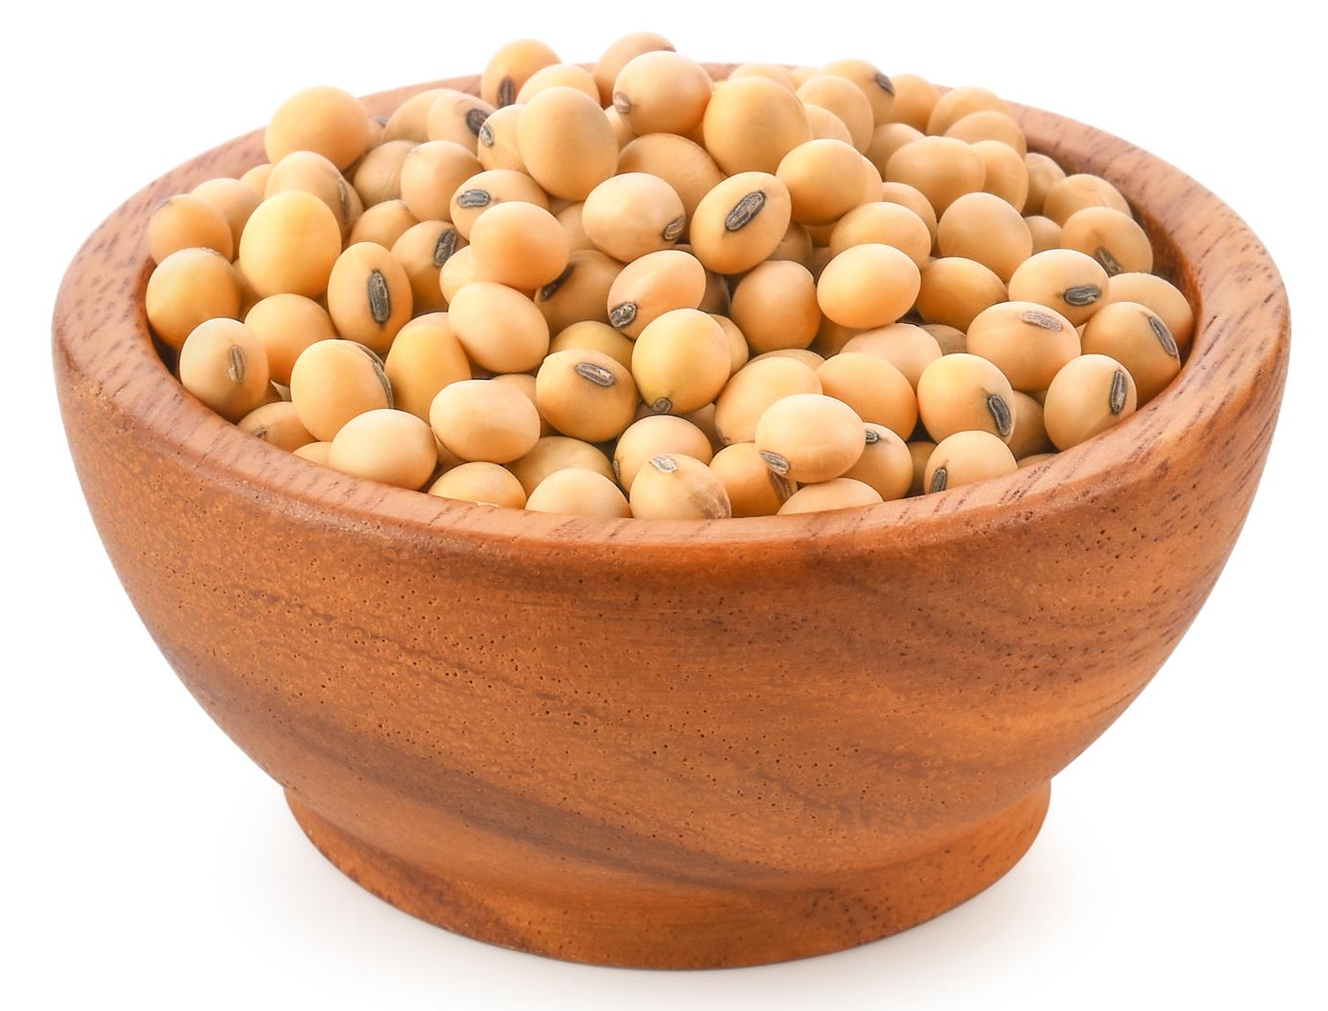
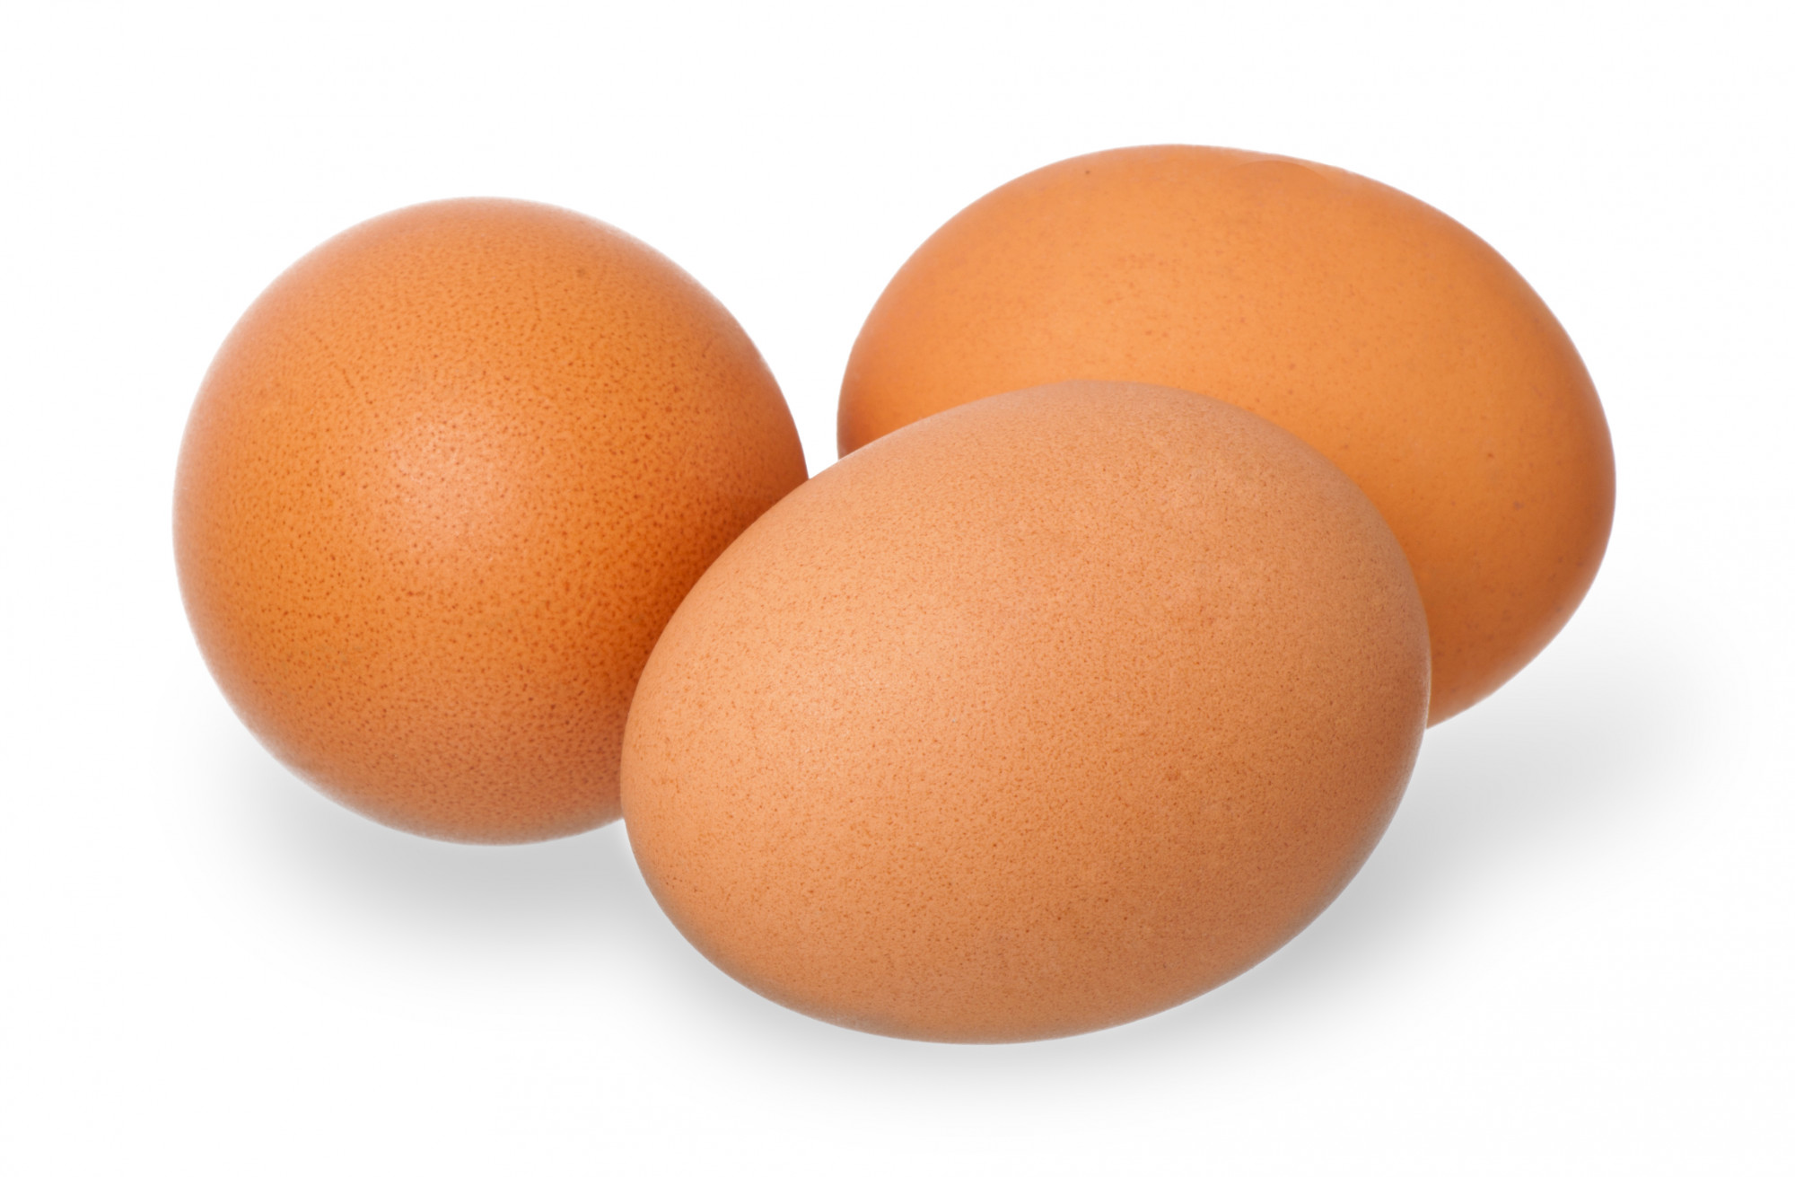
Food Groups: Proteins
Key Consumer Message:
Choose low-fat or lean meats and poultry including a variety of protein sources (animal and plant).
How much is needed?:
Generally, men and women need 5½–6 oz every day
What counts as an ounce?
1 ounce (30g) of meat, poultry or fish
¼ cup cooked beans
1 egg
½ ounce of nuts or seeds
Notes:
Have to know how many ounces but not what makes an ounce

Slide 23

Food Groups: Dairy
Most Dairy Group choices should be fat-free or low-fat.
Foods made from milk that retain their calcium content are part of the group.
Intake of dairy products is linked to improved bone health, and may reduce the risk of osteoporosis.
Quantity needed for adults is 3 cups of milk or equivalent per day.

Slide 24

Food Groups: Dairy
Key Consumer Message:
Switch to fat-free or low-fat (1%) milk (or dairy).
How much is needed?
Consume 3 cups (700 ml) per day of fat-free or low-fat milk or equivalent milk products
What counts as a cup?
1 cup of milk, yogurt, or soymilk (soy beverage)
1 ½ ounces of natural cheese
2 ounces of processed cheese

Slide 25


Food Groups: Fruits and Vegetables
Focus on fruits (fresh, canned, frozen, or dried) and limit the consumption of fruit juice.
Color your plates with dark green, red and orange vegetables.
We need around 5 fruits and vegetables per day.
Eating a diet rich in vegetables and fruits as part of an overall healthy diet may reduce risk for heart disease, including heart attack and stroke and some type of cancers.
Most fruits are naturally low in fat, sodium, and calories and rich in fibers and vitamins.

Slide 26
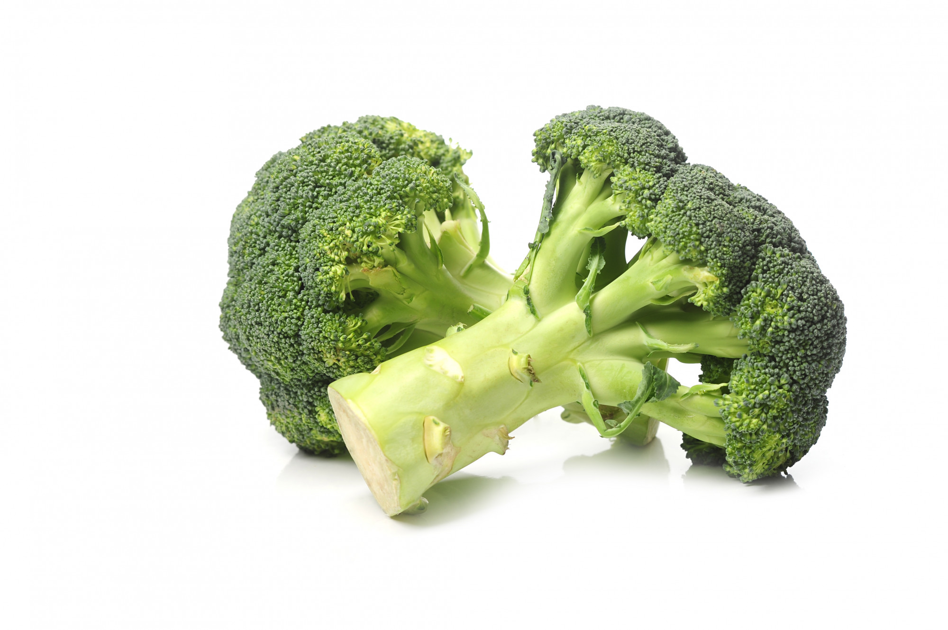

Food Groups: Fruits and Vegetables
Key Consumer Message:
Make half your plate fruits and vegetables.
How much is needed?:
2 cups of fruit (500g)
2 ½ cups (600g) of vegetables per day
What counts as a cup?
1 cup of fruit or 100% fruit juice or ½ cup of dried fruit
1 cup of raw or cooked vegetables or vegetable juice
2 cups of raw leafy greens

Slide 27

Food Groups: Oils
Key Consumer Message:
Consume less than 10 percent of calories from saturated fatty acids and less than 300 mg/day of cholesterol, and consume trans fatty acid as low as possible.
Keep most fats coming from sources of monounsaturated and polyunsaturated fatty acids such as fish, nuts, and vegetable oils.
Select meat, poultry, and milk or milk products that are lean, low-fat, or fat-free.

Slide 28

What Does a Healthy
Eating Pattern Consist Of?
A variety of vegetables from all subgroups:
Including all fresh, frozen, dried, and canned versions in cooked or raw form, dark greens, red and orange, beans and peas, and starchy vegetables
Fruits, especially whole fruits:
Including fresh, canned, frozen, dried, and 100% fruit juice, are essential to a healthy eating pattern
Notes:
Recommendations for “consuming a healthy eating pattern” begin with an emphasis on the consumption of fruits and vegetables.
As you know, a healthy eating pattern includes a variety of vegetables. Those of you working in child nutrition programs are familiar with the vegetable subgroups, including dark greens, red and orange, beans and peas, as well as starchy vegetables.
In addition, vegetables in all forms, including fresh, frozen, dried, and canned versions, and cooked or raw form, may all be included in the diet pattern.
In addition, whole fruits, including fresh, canned, frozen, dried, and 100% fruit juice, are essential to a healthy eating pattern.

Slide 29

What Does a Healthy
Eating Pattern Consist Of?
Oils:
Oils should replace solid fats
Major source of essential fatty acids and Vitamin E

Slide 30



Hidden Components in Eating Patterns

Slide 31

What Does a Healthy
Eating Pattern Limit?
The intake of trans fats should be as low as possible
Saturated fats should be limited to less than 10% of the total daily caloric intake
Consume less than 10% of calories per day from added sugar
Consume less than 2,300 milligrams per day of sodium
If alcohol is consumed, do so in moderation
Notes:
Saturated fats should be limited to less than 10% of the total daily caloric intake, while the intake of trans fats should be as low as possible.
It is recommended that added sugars be limited to less than 10% of the total caloric intake per day.
Sodium should also be consumed in quantities less than 2,300mg/day for adults and children ages 14 years and older; adults with prehypertension and hypertension should limit their intake to less than 1,500mg/day.

Slide 32


Healthy Physical Activity Patterns
Adults
Aim for 150 minutes of moderate intensity physical activity per week, and at least 2 days of muscle-strengthening exercises per week
Youth Ages 6-17 Years
At least 60 minutes of physical activity per day including aerobic, muscle-strengthening, and bone-strengthening activities
Notes:
The Physical Activity Guidelines include recommended amounts and types of physical activity for optimum health.
Adults need at least 150 minutes of moderate intensity physical activity and should perform muscle-strengthening exercises on 2 or more days each week.
Youth, ages 6 to 17 years, need at least 60 minutes of physical activity per day, including aerobic, muscle-strengthening, and bone-strengthening activities.
Just as individuals can achieve a healthy eating pattern in a variety of ways, they can engage in regular physical activity in a variety of ways throughout the day and by choosing activities they enjoy.
Beyond becoming more active, the Dietary Guidelines encourage a shift away from sedentary behaviors and encourage limiting screen time. The appendix provides a list of Federal resources, including handouts, online assessments, trackers, and interactive websites that can be used to help motivate individuals to make healthy physical activity choices.

Slide 33

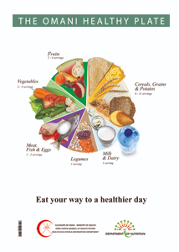
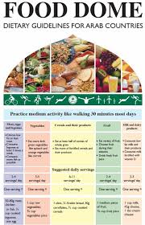
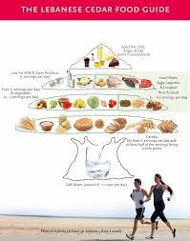

Dietary Guidelines in Arab Countries

Slide 34

Information
For Your
Interest

Slide 35
